Slide 1
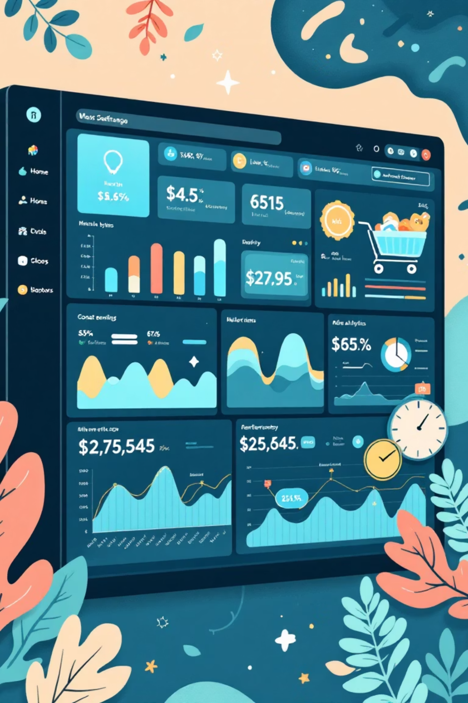
Customer Shopping Behavior Analysis
Analyzing 3,900 purchases to uncover insights into spending patterns, customer segments, and product preferences that drive strategic business decisions.

Slide 2

Dataset Overview
3,900
18
Total Purchases
Data Points
Comprehensive transaction records analyzed
Features covering demographics, purchases, and behavior
50
25
Locations
Product Types
Geographic diversity across customer base
Diverse inventory across four categories

Slide 3
Data Preparation & Engineering
01
02
Data Loading & Exploration
Missing Data Handling
Imported dataset using pandas, analyzed structure with df.info() and summary statistics
Imputed 37 missing Review Rating values using median rating per product category
03
04
Feature Engineering
Database Integration
Created age_group bins and purchase_frequency_days columns for deeper analysis
Connected to MySQL and loaded cleaned data for SQL analysis

Slide 4
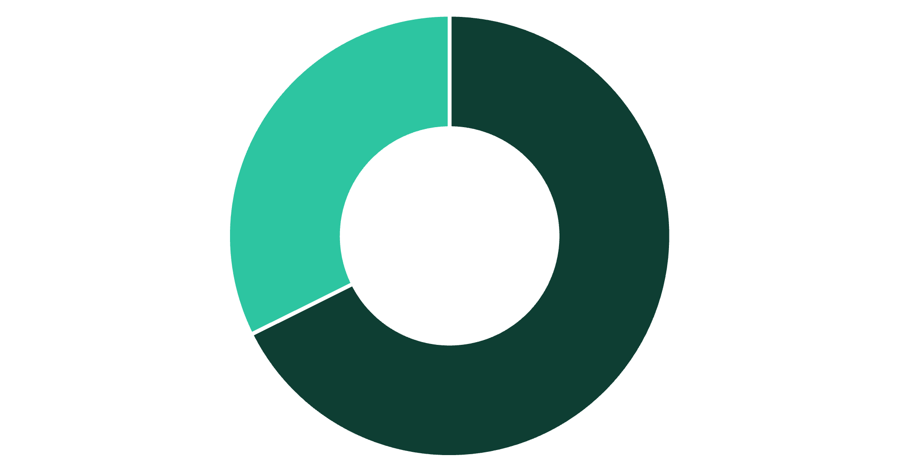
Revenue Insights by Gender
Male Customers Drive Revenue
Male customers generate $157,890 in total revenue compared to $75,191 from female customers, representing 68% of total sales.
This significant gap suggests opportunities for targeted marketing to female demographics.
Male
Female

Slide 5
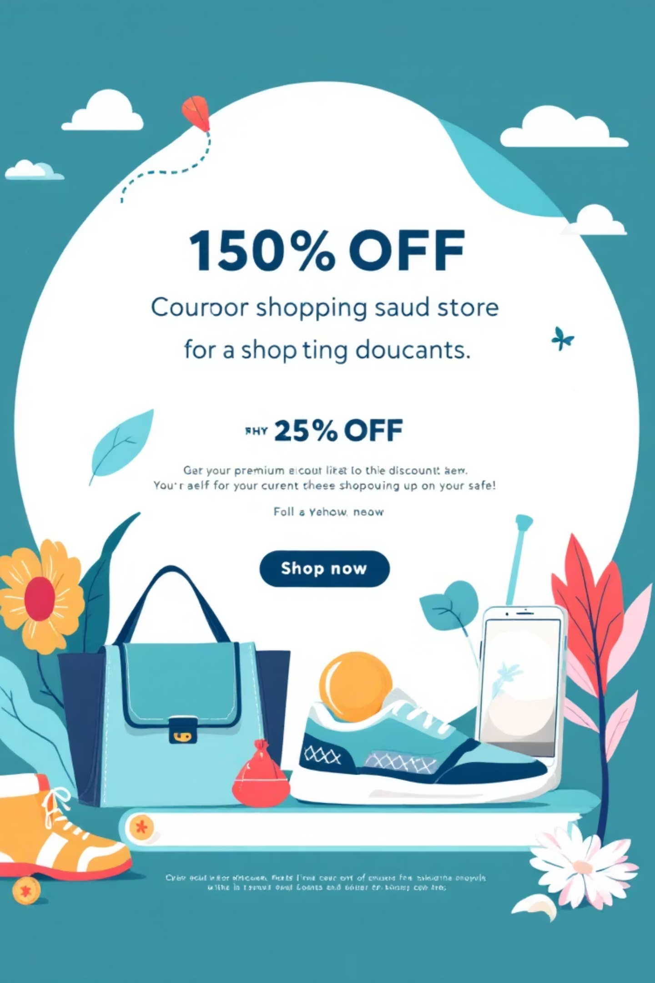
Smart Discount Users
High-Value Discount Shoppers
839 customers used discounts while spending above the $59.76 average purchase amount
Strategic Opportunity
These savvy shoppers balance value-seeking with premium purchases, ideal for loyalty programs

Slide 6
Top-Rated Products & Shipping Analysis
1
2
3
4
5
Gloves
Sandals
Boots
Hat
Skirt
Highest rated at 3.86 average
Strong performance at 3.84 average
Customer favorite at 3.82 average
Popular choice at 3.80 average
Well-received at 3.78 average
1
2
Standard Shipping
Express Shipping
$58.46 average purchase
$60.48 average purchase
Express shipping customers spend 3.5% more on average, indicating higher-value customers who prioritize convenience.

Slide 7
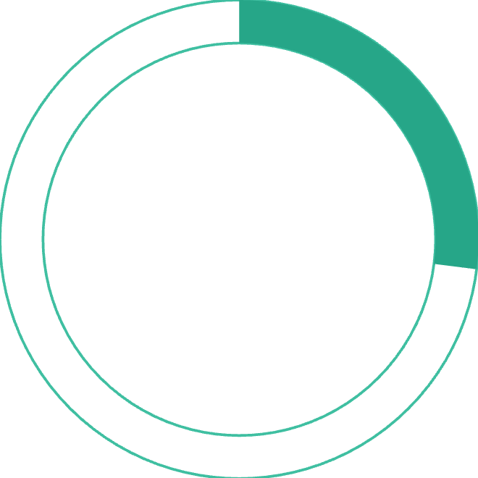

Subscription Analysis
27%
73%
Subscribers
Non-Subscribers
1,053 customers with subscriptions
2,847 customers without subscriptions
Subscribers: $59.49 avg spend, $62,645 total revenue
Non-Subscribers: $59.87 avg spend, $170,436 total revenue
Similar spending patterns suggest untapped subscription conversion potential

Slide 8






Customer Segmentation & Product Preferences
1
New (83)
2
Returning (701)
3
Loyal (3,116)
The customer base shows strong loyalty with 80% classified as loyal customers, while 18% are returning and only 2% are new. This distribution suggests effective retention but highlights the need for customer acquisition strategies.
Clothing Leaders
Top Accessories
Footwear Favorites
Blouse (171), Pants (171), Shirt (169)
Jewelry (171), Sunglasses (161), Belt (161)
Sandals (160), Shoes (150), Sneakers (145)

Slide 9
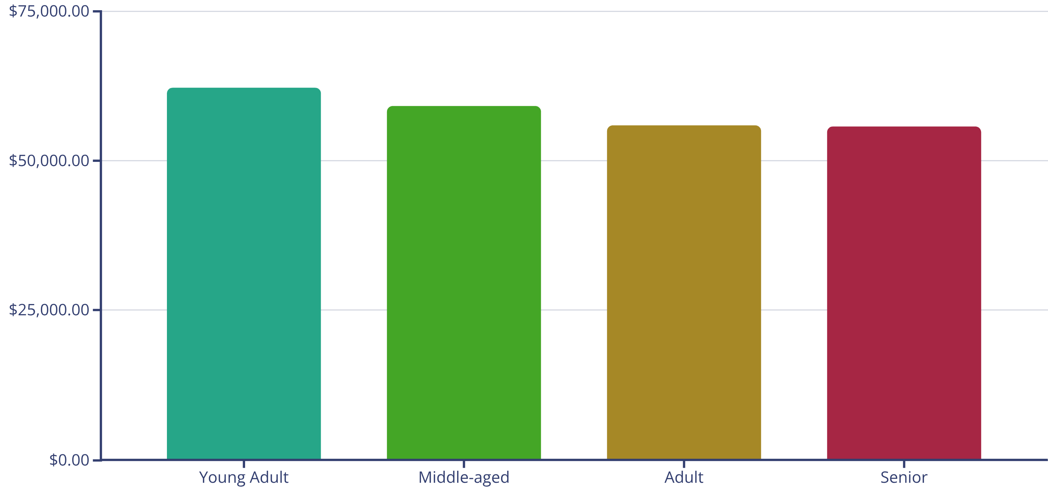
Revenue by Age Group
Young adults lead revenue generation at $62,143, followed closely by middle-aged customers. Relatively balanced distribution suggests broad market appeal across demographics.

Slide 10

Strategic Business Recommendations
Boost Subscription Adoption
Promote exclusive benefits and incentives to convert the 73% non-subscriber base, focusing on loyal customers with 5+ purchases who show 958 repeat buyers already subscribed.
Enhance Loyalty Programs
Reward repeat buyers to accelerate their journey into the loyal segment, leveraging the strong 80% loyal customer base as proof of effective retention strategies.
Optimize Discount Strategy
Review discount policies to balance sales growth with margin protection, particularly for high-discount products like Hats (50% discount rate) and Sneakers (49.66%).
Strategic Product Positioning
Highlight top-rated products (Gloves, Sandals, Boots) and best-sellers (Blouse, Jewelry, Pants) in marketing campaigns to drive conversion and customer satisfaction.
Targeted Marketing Focus
Concentrate efforts on high-revenue young adult segment and express-shipping users who demonstrate 3.5% higher average purchase values, indicating premium customer potential.

